Slide 1

INSTAGRAM USER ANALYTICS
J ATHREYA SHARMA

Slide 2

MARKETING

Slide 3

Task 1: Rewarding Most Loyal Users
Command:
SELECT * FROM users ORDER BY created_at ASC LIMIT 5;
APPROACH:-
To find the inactive users I have used left join
Tech-stack used:-
I used mysql because it provides graphs to understand easily
Insights:-
I have been understood that how left join works in real life

Slide 4
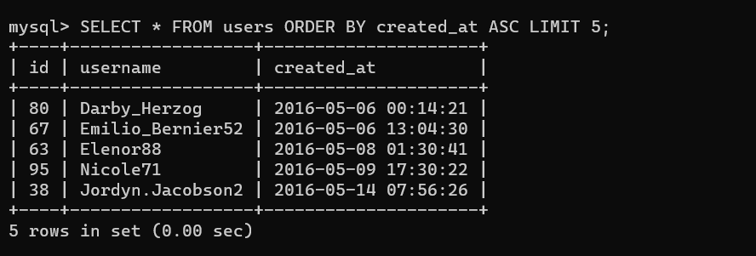

Slide 5
Task 2:Remind Inactive Users To Start Posting
Command :
SELECT users.id, users.username FROM users LEFT JOIN photos ON users.id = photos.user_id WHERE photos.id IS NULL;
APPROACH:-
To find the Identify the winner of the contest
Tech-stack used:-
I used mysql because it provides graphs to understand easily
Insights:-
I have been understood that how the filtering process have be done.

Slide 6
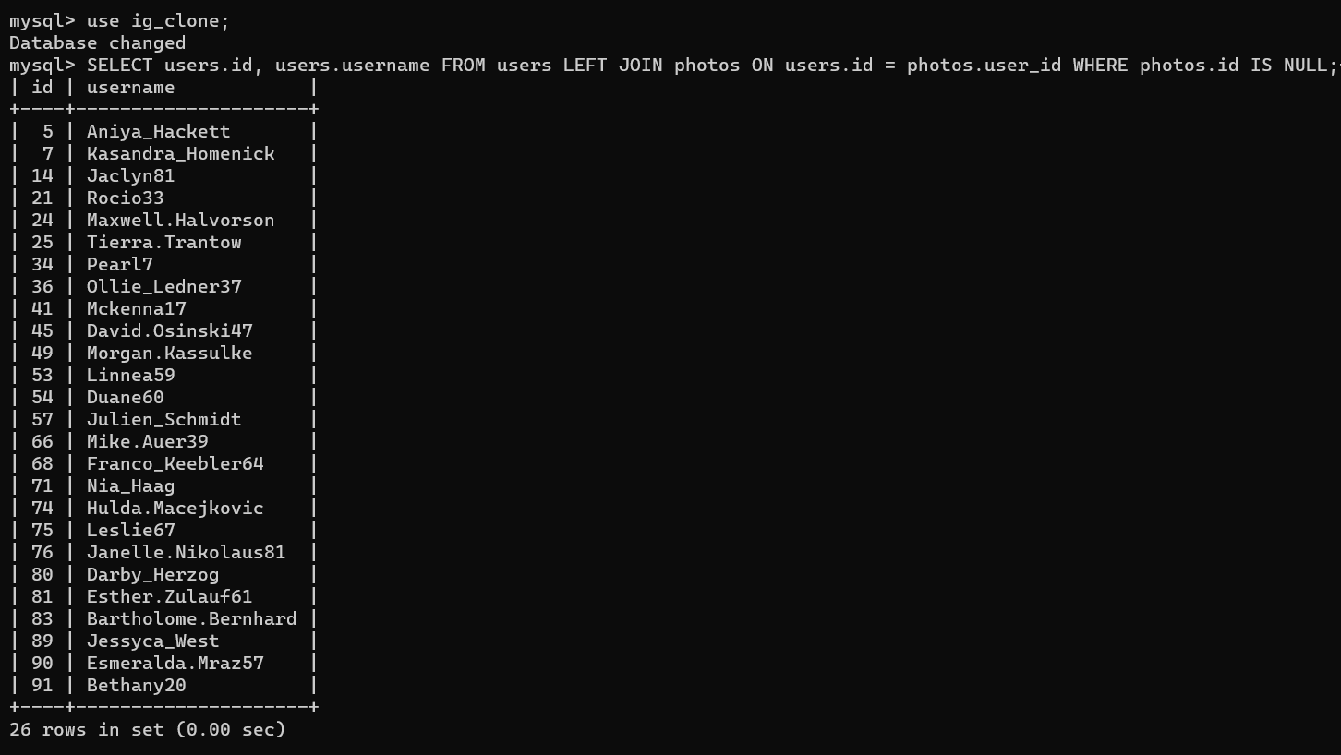

Slide 7

Task 3:Remind Inactive Users To Start Posting
Command to execute the question is :
SELECT user_id, COUNT(*) as num_likes
FROM likes
GROUP BY user_id
ORDER BY num_likes DESC
LIMIT 1;
Approach:
To answer this query I have counted the number of likes table, grouped the results by userid and then sorted the results in descending order
Tech-Stack used:
I Used MySQL Command Client 8.0
Insights:
I Understood how count() method works and also grouped them according to userid and ordered by num_likes and set the limit to 1 because I had to declare the contest winner.

Slide 8
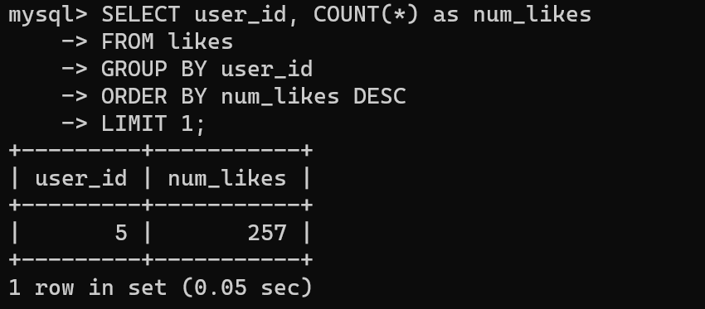

Slide 9
Task 4 : Hashtag Researching
Command to execute the question is :
SELECT t.tag_name, COUNT(*) AS num_posts
FROM tags t
JOIN photo_tags pt ON t.id = pt.tag_id
JOIN photos p ON pt.photo_id = p.id
GROUP BY t.tag_name
ORDER BY num_posts DESC
LIMIT 5;
Approach: To answer this query I have retrieved tag names from the tags table and joined it with the ‘photo_tags’ and ‘photos’ table to get the number of posts associated with each tag.
Tech-Stack used: I Used MySQL Command Client 8.0
Insights: I joined tags table with photo_tags and grouped the results by tag name and order by sorts the results in descending order based on the number of posts.

Slide 10
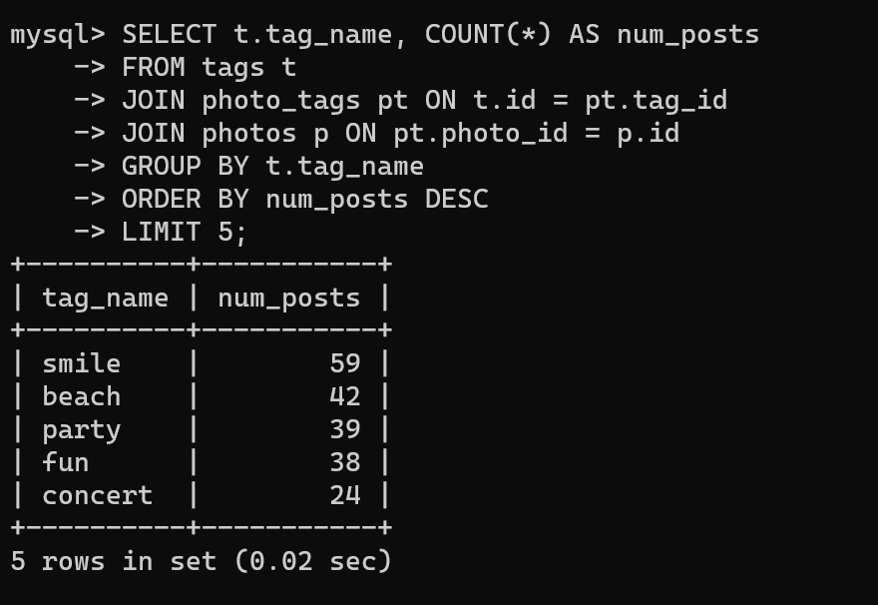

Slide 11

Task 5 : Launch AD Campaign
Command to execute the question is :
SELECT t.tag_name, COUNT(*) AS num_posts
FROM tags t
JOIN photo_tags pt ON t.id = pt.tag_id
JOIN photos p ON pt.photo_id = p.id
GROUP BY t.tag_name
ORDER BY num_posts DESC
LIMIT 5;
Approach: To implement this query I extracted the day of the week from the created_at column using DAYNAME() and then counted the number of registrations for each day using count().
Tech-Stack used: I Used MySQL Command Client 8.0
Insights: As a result set that shows the number of registrations for each day of week. In this manner we can give the team about which day would be the best to launch AD’s.

Slide 12
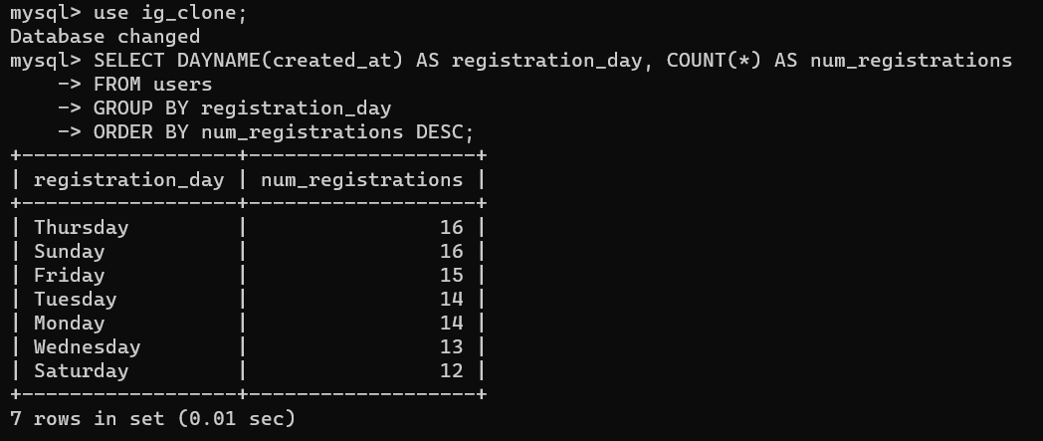

Slide 13

Investor Metrics

Slide 14
Task 1 : User Engagement
Command to execute the question is :
SELECT AVG(post_count) AS average_posts
FROM (
SELECT user_id, COUNT(*) AS post_count
FROM photos
GROUP BY user_id
) AS post_counts;
For total number of photos on Instagram:
SELECT COUNT(*) AS total_photos
FROM photos;
Approach: To implement this query I used average aggregate function to see the average number of posts made by Instagram users.
Tech-Stack used: I Used MySQL Command Client 8.0
Insights: As a result, we will get the average number of posts made by users on Instagram, total number of photos on Instagram. These insights will help us to understand the posting activity of users on Instagram , the total number of photos available on Instagram.

Slide 15
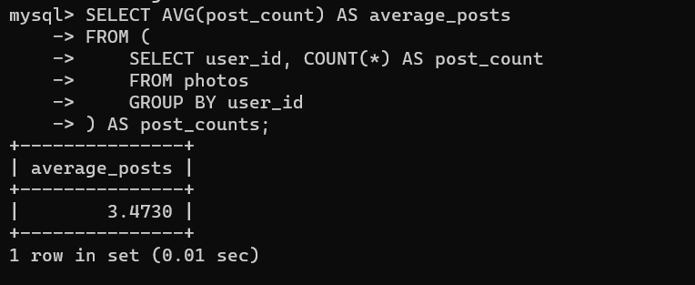

Slide 16
Task 2: Bot & Fake Accounts
Command to execute the question is :
SELECT user_id, COUNT(DISTINCT photo_id) AS total_photos_liked
FROM likes
GROUP BY user_id
HAVING total_photos_liked = (SELECT COUNT(DISTINCT id) FROM photos);
Approach: To implement this query I retrieved ‘user_id’ from likes table and counted the distinct ‘photo_id’ values for each user. The ‘having’ clause filters the results to include only those users who have like every single photo on the site, which can be determined by comparing ‘total_photos_liked’ with total number of distinct photo ID’s in photos table.
Tech-Stack used: I Used MySQL Command Client 8.0
Insights: As a result, we will get a list of user_ids wo have liked every single photo on the site. These accounts may posses suspicious behaviour as it is unlikely to users to like every single photo

Slide 17
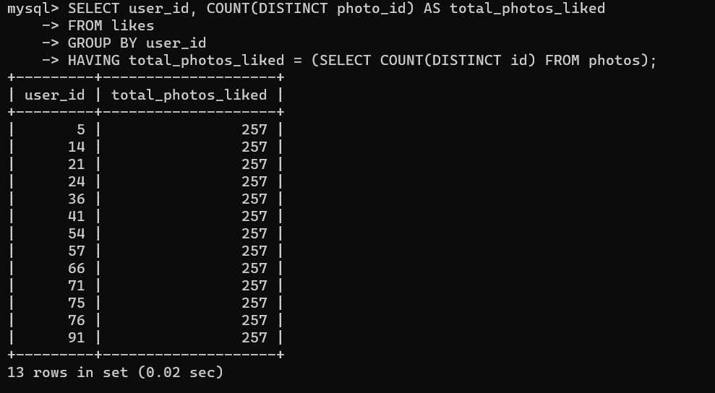

Slide 18


Thank you

